Slide 1
Blossom Bank Case Study- Online Payment Fraud Detection System
Developed by: Anuoluwapo Kehinde

Slide 2

CONTENTS
Introduction
Problem to be solved with the data mining
Significance of the research
Methodology:
Exploratory data Analysis
Feature engineering
Conclusion

Slide 3

INTRODUCTION
Blossom Bank also known as BB PLC is known to be one of the most reputable bank in the UK.
BB PLC is a multinational financial services group, that offers retail and investment banking, pension management, asset management and payments services, also known for its monetary thoroughness and consistency over the years.
Blossom Bank has its headquarter in London, UK.

Slide 4

ARTICULATED PROBLEM
Blossom Bank wants to build a Machine Learning model to predict online payment fraud.

Slide 5

SIGNIFICANCE OF THE RESEARCH
The main reason Blossom Bank wants to build a Machine Learning model to predict online payment fraud is to eliminate fraudulent online transaction.
If a solution is proffer, Blossom Bank will be in an awesome position to become more relevant among other banks in the United Kingdom, as well as guarantee their customers of safe and convenient online payments in the long run.

Slide 6

METHODOLODY
For my methodology, two approaches were taken.
Exploratory data Analysis
Feature engineering

Slide 7
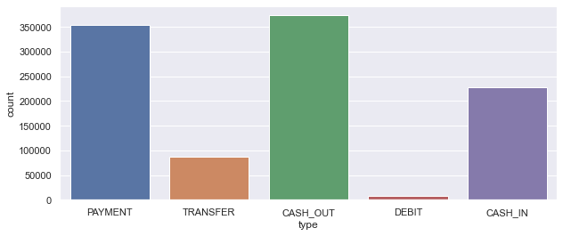
EXPLORATORY DATA ANALYSIS

Slide 8
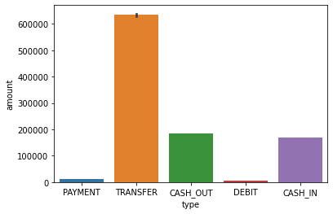
Cash out and Payment are the most common type of transactions, but Transfer type has the maximum amount of money being transferred to the recipient.

Slide 9
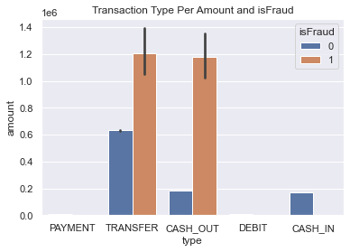

Slide 10

FEATURE ENGINEERING
For the feature engineering, two models were employed.
Logistics Regression
Decision Tree Classifier
Logistics Regression Model Results
99.89962568247384% of the Transaction is Non-Fraud
0.10037431752616044% of the Transaction is Fraud
Decision Tree Classifier Results
100.0% of the Transaction is Non-Fraud
0.0% of the Transaction is Fraud

Slide 11

CONCLUSION
From this research, the ease of online banking helped a lot of financial institutions in making smooth transactions but for Blossom Bank to stand out from other banks, it could be projected that Blossom bank can eliminate online payment fraud with the aid of the projected two models which are very precise and virtually accurate for predictions. There is a need to put a halt to complaints from the bank users related to online payment fraud.
Finally, bearing in mind the rate of fraudulent transactions in the global horizon, it is an enormous step that Blossom Bank the bank has taken to eliminate the risks of fake online payments and its negative impacts today, tomorrow nearest future.

Slide 12


